Slide 1
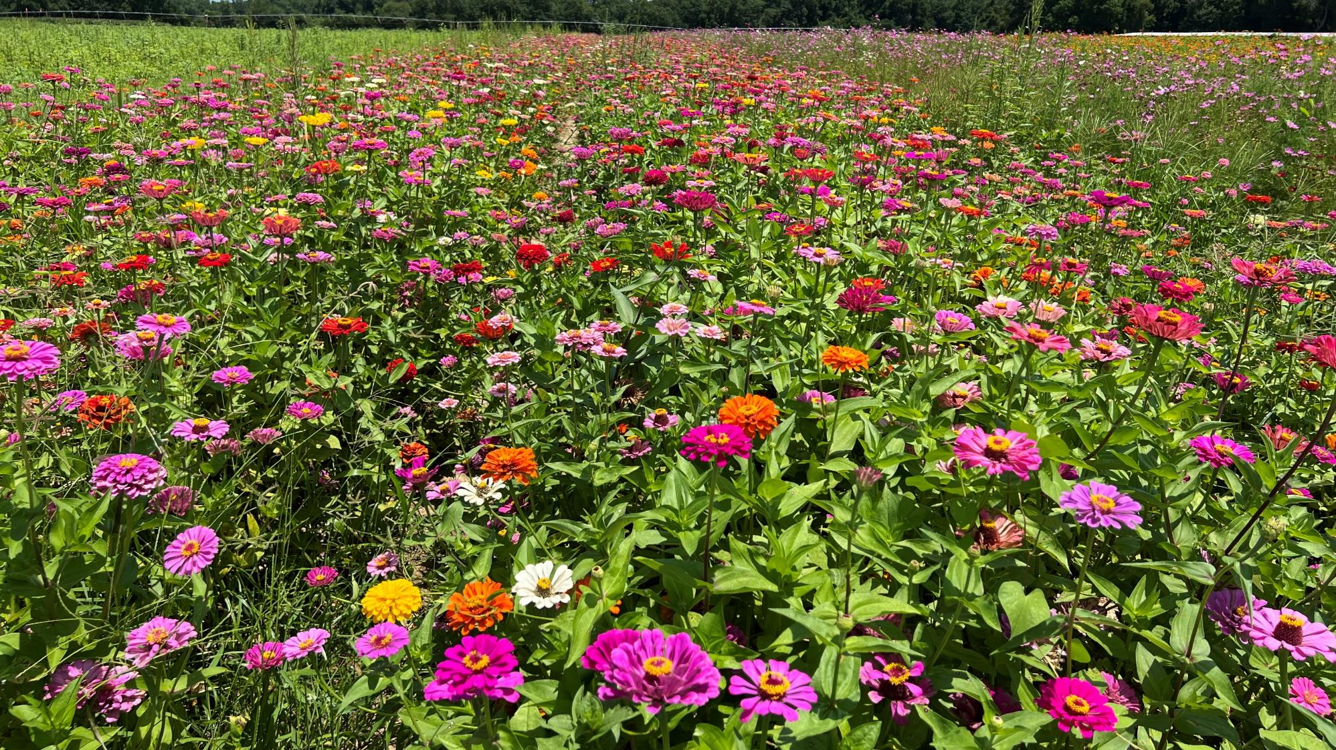
Pollinators / Cover Crops / Sustainability
Taylor Randell Singleton
Extension Sustainability Specialist

Slide 2
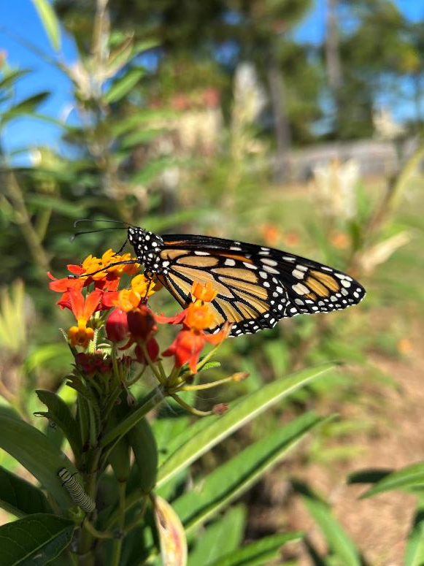
Pollinator Habitat on the Farm
Impact on day-to-day life:
  30% of world’s food is pollinated
  130 fruits and vegetable plants
  1 in 3 bites of food
Why should you care???
  Pollinators support $18-27 billion in US crop yields annually
  Habitat also supports predators/parasitoids

Slide 3
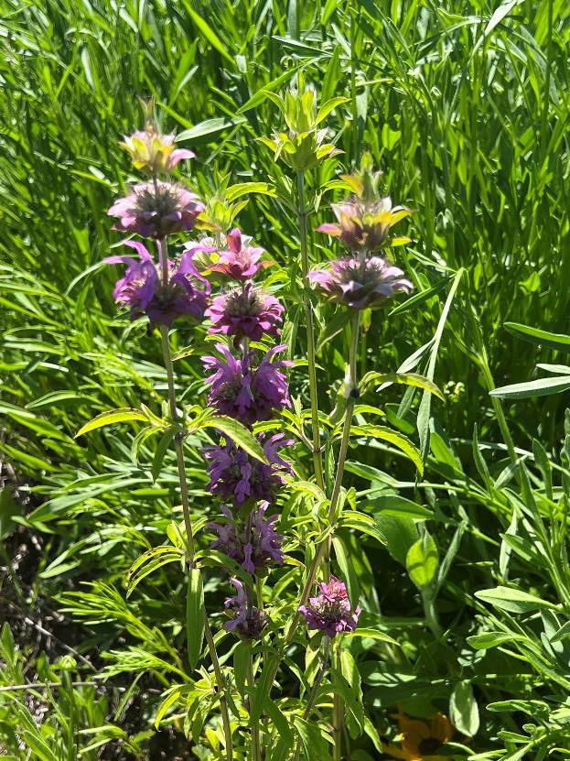
Pollinator Habitat on the Farm
Implications for pesticide stewardship
  Supporting endangered/listed/sensitive species
  Promoting biodiversity
  Mitigation for runoff/erosion
Indirect ROI…..hard to quantify
  Don’t directly increase yield, etc.
  Extra expense to install/maintain

Slide 4
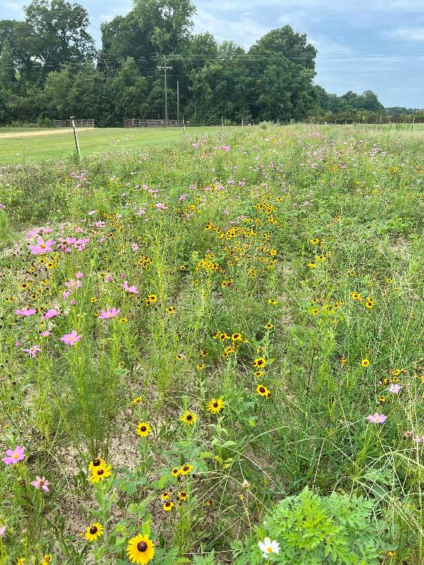
Support @ National/State Level
NRCS funding to install habitat/benefit pollinators on working farms
  30+ cost-share programs
Habitat installation
Field borders
Riparian buffers
Filter strips
Native grasslands

Slide 5
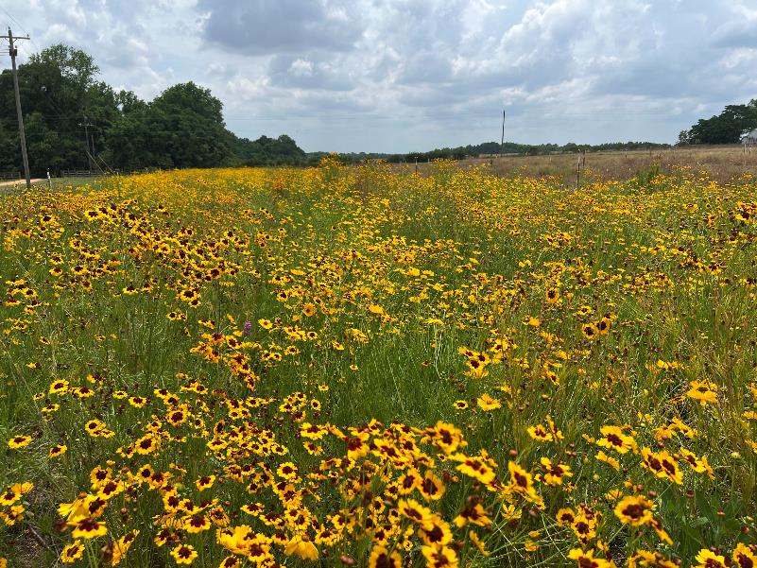
NRCS Programs
Georgia state standards:
  9 broadleaves (flowering)
  1 native grass
Challenging to implement
  Low emergence
  Not competitive
  Extensive weed pressure
How to control weeds in pollinator sites??

Slide 6
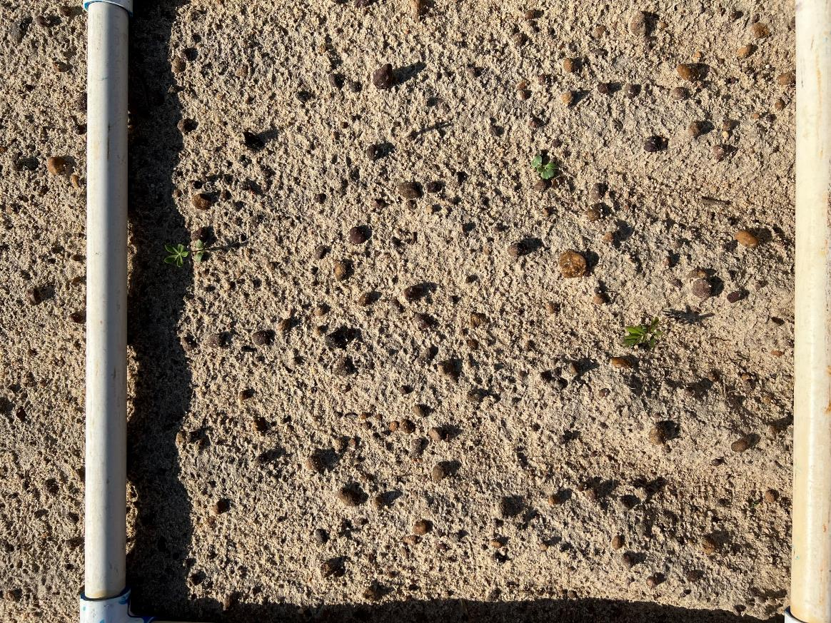
Year 1 = disaster

Slide 7
Switch Focus → Commercialized Annuals
Start with commercialized annuals, add in natives after establishment
  Fast growing
  Hardy
  Herbicide tolerance?
Focus on PRE herbicides, screen for tolerance across wide range of products
  Zinnia, cosmo, marigold, Mexican sunflower

Slide 8

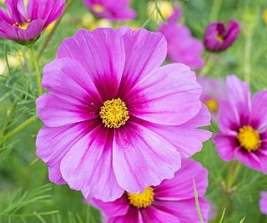
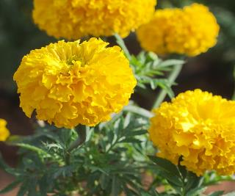
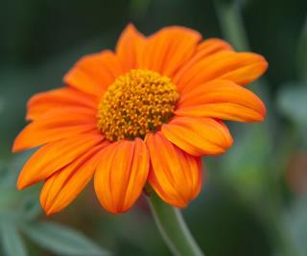
Screening for Everything (PRE)
Alite
Axiom
Brake
Cadre
Caparol
Command
Dacthal
Devrinol
Dual Magnum
Eptam
Goal
Prowl
Pursuit
Reflex
Spartan
Staple
Treflan
Valor
Warrant

Slide 9
Screening for Everything (PRE)
YES | NO | MAYBE (adjust rate)
Dachtal | Alite | Axiom
Devrinol | Brake | Dual Magnum
Prowl | Cadre | Warrant
Treflan | Caparol
 | Command
 | Eptam
 | Goal
 | Pursuit
 | Reflex
 | Spartan
 | Staple
 | Valor

Slide 10
Creating a Systems Approach to Weed Control*
*Fall 2024 – 1 location; 3 reps

Slide 11
Understanding Planting Method
Ground Coverage (%)
Ratio: Zinnia/Cosmo/Marigold/Mex Sun

Slide 12
Planting Method Influences Bloom

Slide 13
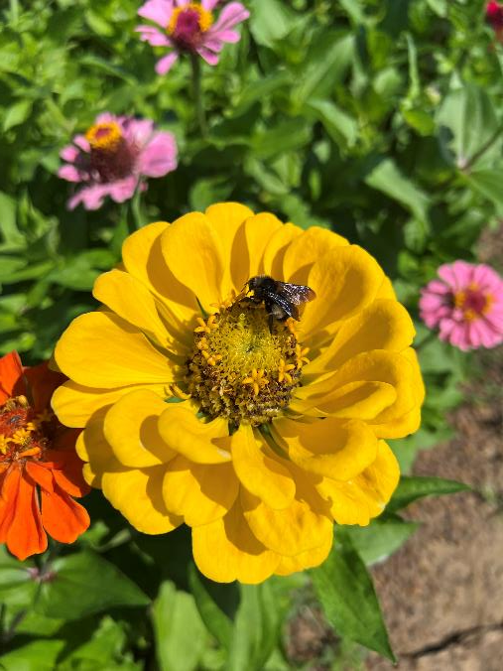
UGA vs NRCS
2 species “mixes”
  UGA mix:
    Zinnia, Cosmo, Marigold, Mexican sunflower
  NRCS mix:
    9 broadleaves
      Lanceleaf coreopsis, perennial lupine, lemon mint, sensitive pea, annual Indian blanket, slender lespedeza, showy goldenrod, greyheaded coneflower, starry rosinweed
    1 grass
      Yellow Indiangrass
3 herbicide programs
  NTC, PRE treflan, POST cadre (NRCS only)

Slide 14
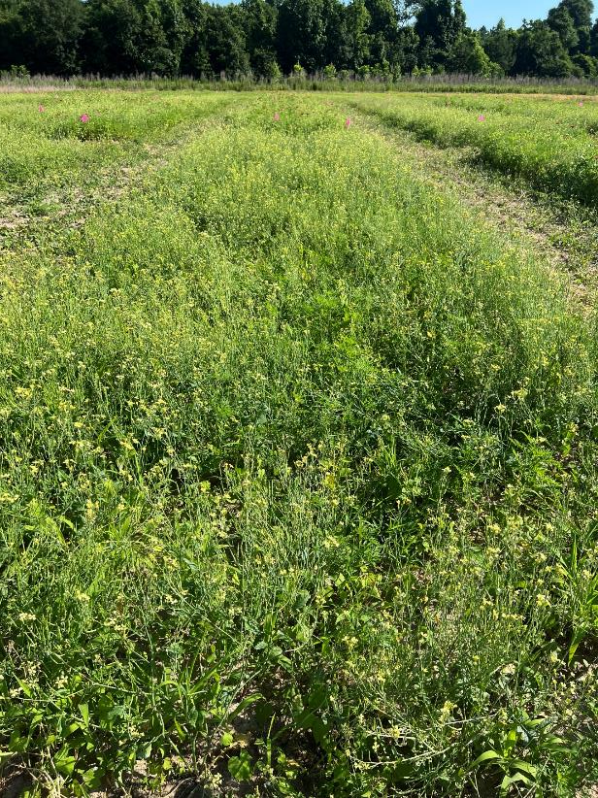
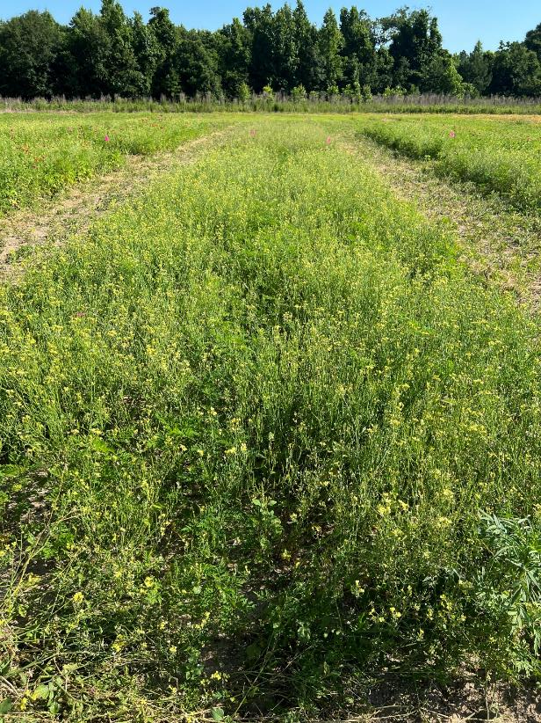
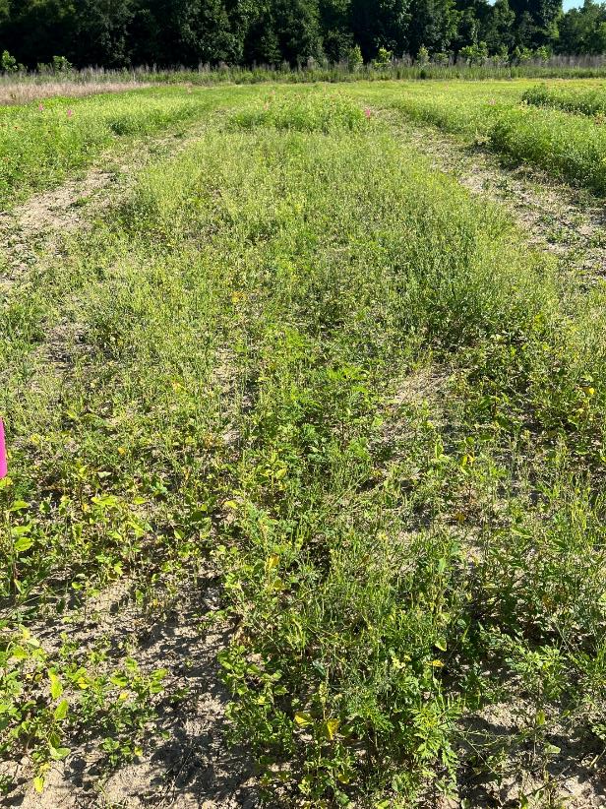
NRCS Mixture – Site 1
Flwr1-24
51 DAP
No herbicide
PRE: treflan
POST: none
PRE: none
POST: cadre

Slide 15
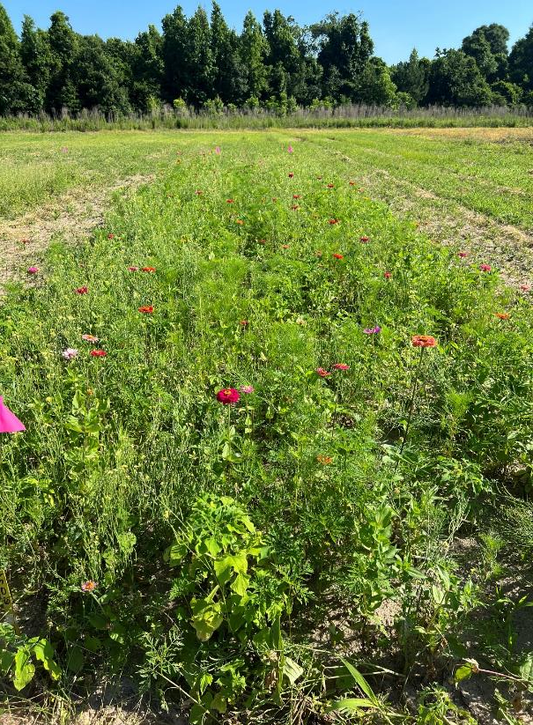
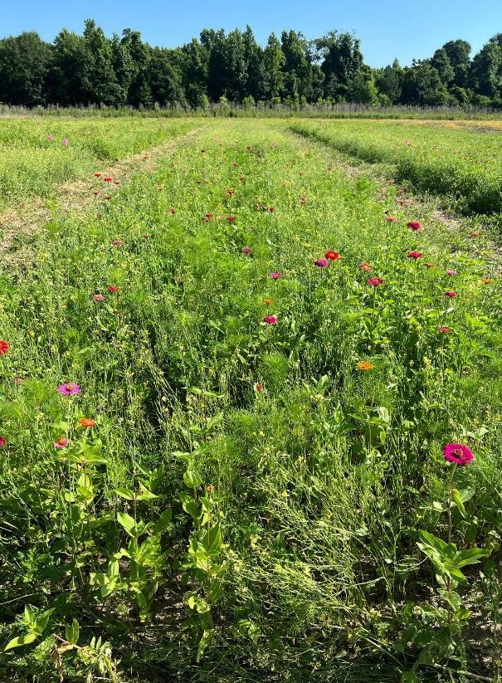
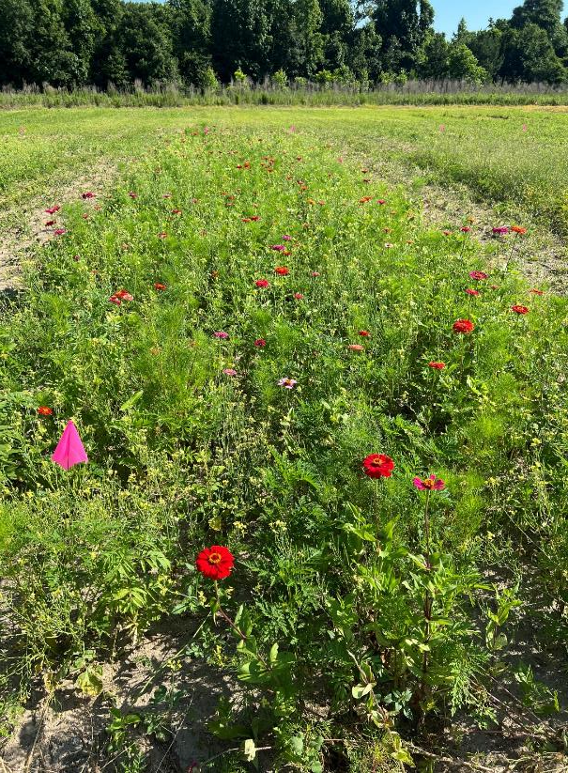
UGA Mixtures – Site 1
Ratios = Zinnia/Cosmo/Marigold/Mexican sunflower
Flwr1-24
51 DAP
25/25/25/25
40/30/20/10
“low” seeding rate
40/30/20/10
“high” seeding rate

Slide 16
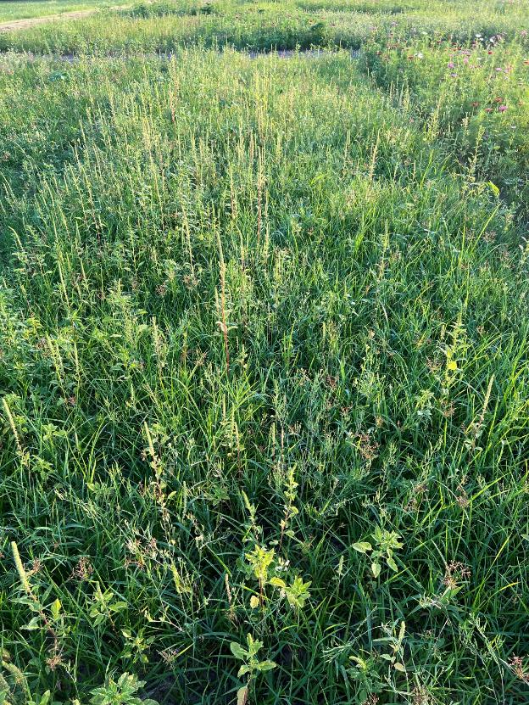
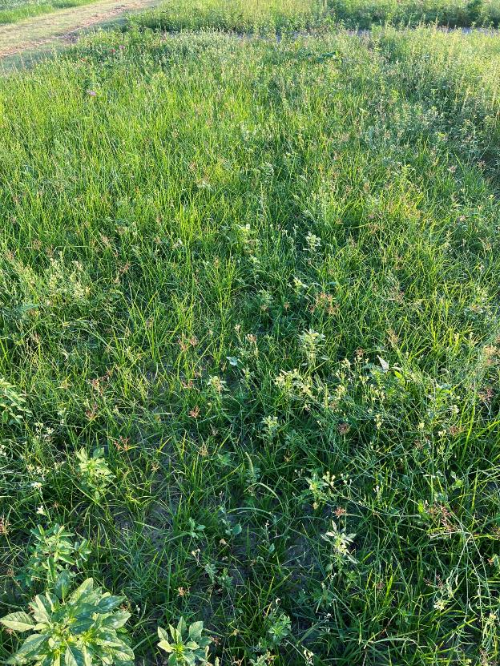
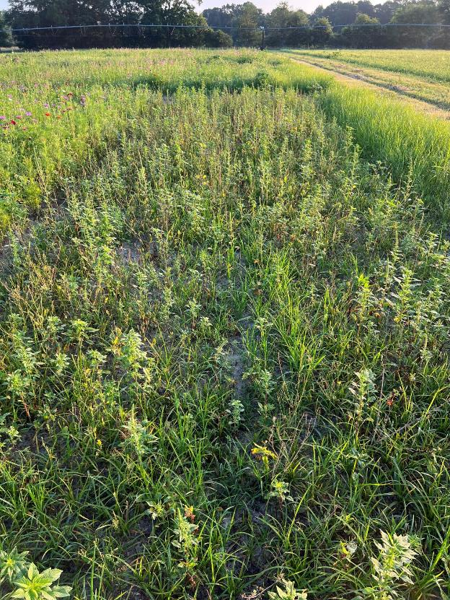
NRCS Mixture – Site 2
Flwr2-24
Ponder Farm
51 DAP
No herbicide
PRE: treflan
POST: none
PRE: none
POST: cadre

Slide 17
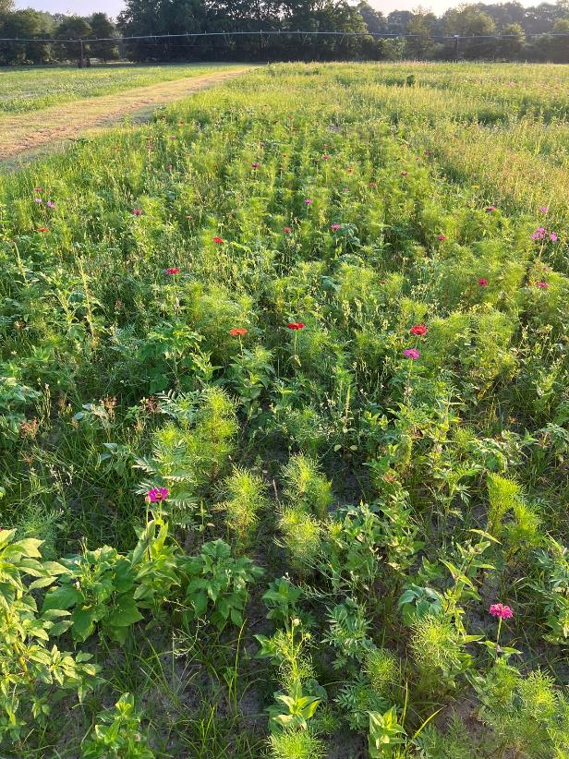
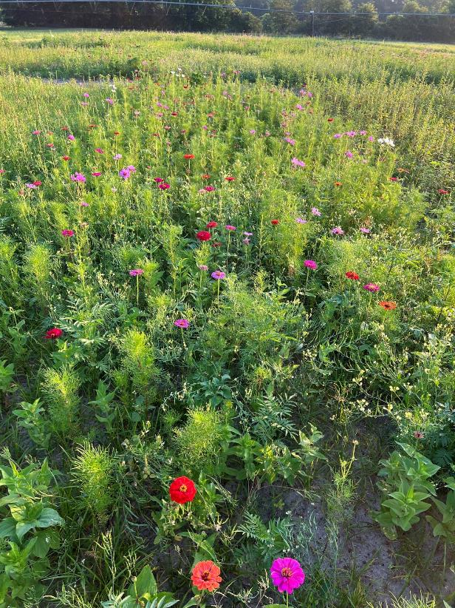
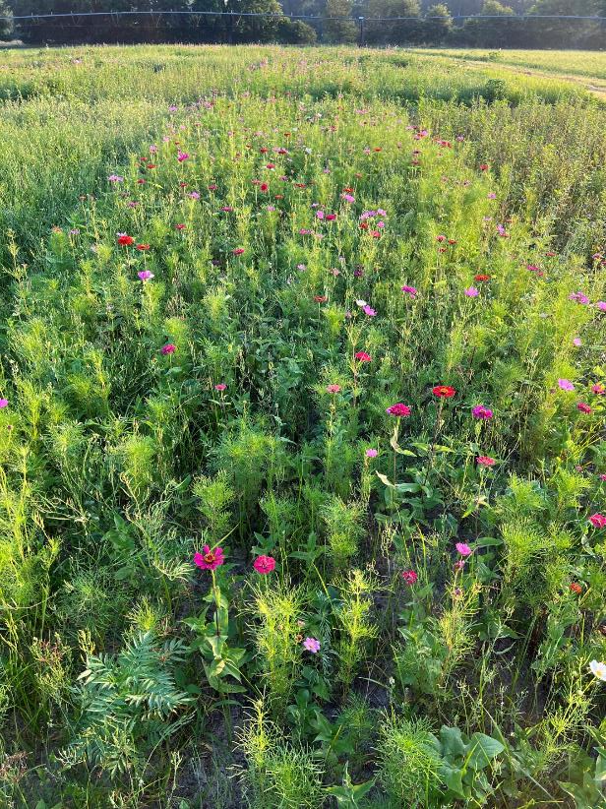
UGA Mixtures – Site 2
Ratios = Zinnia/Cosmo/Marigold/Mexican sunflower
Flwr2-24
Ponder Farm
51 DAP
25/25/25/25
40/30/20/10
“low” seeding rate
40/30/20/10
“high” seeding rate

Slide 18

Cover Crop Survey
Please fill out my survey!!!
  Research directions
  New/updated resources
  Information delivery to you
  Cost share/incentive programs
You can leave on the table, put in the box, paper airplane to the front…..please just fill it out! ☺

Slide 19
What’s Important?
Variety/cultivar specific to different areas of GA
Seeding rates
  How low can we go?
  Broadcast vs drilled
  Rates between cultivars
Spreading before cash crop harvest
Timing windows (i.e. cover after corn, etc.)
Quantify intangible benefits
ECONOMICS $$$$$$$$

Slide 20
Warm Season Species Evaluation
Species | Broadcast Rate (lb/a)
NTC – Fallow | 0
Sunn Hemp | 50
Buckwheat | 90
Cowpea | 80
Proso Millet | 25
Foxtail Millet | 25
Browntop Millet | 25
Japanese Millet | 12
Pearl Millet | 12
Teff | 12
Sudangrass | 25
Sorghum-Sudangrass | 25
What warm-season covers are suitable?
Row crop or vegetable?
Throw it out and water in?
Data Evaluated
Ground coverage
Weed suppression
Biomass accumulated
Heat tolerance
Height

Slide 21
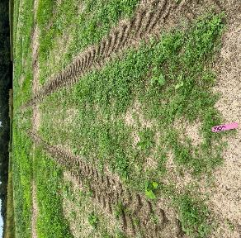
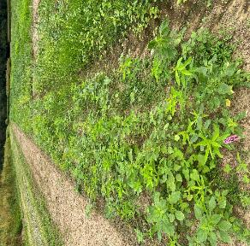
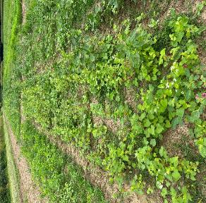
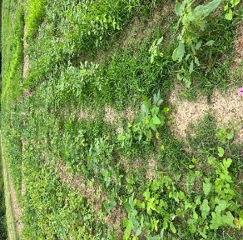
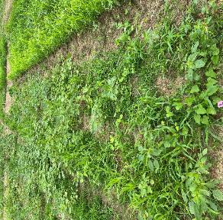
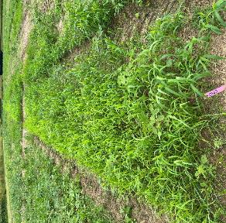
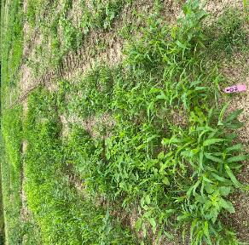
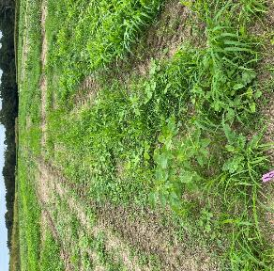
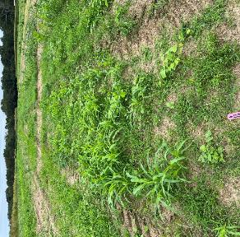
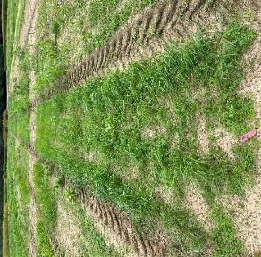
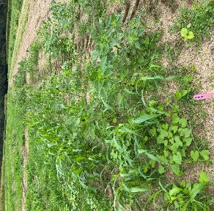
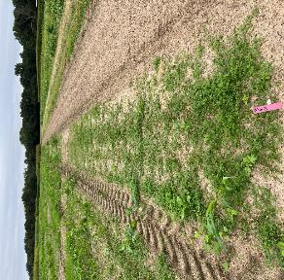
Warm Season Species Evaluation
Fallow
Sunn hemp
Buckwheat
Cowpea
Proso millet
Foxtail millet
Browntop millet
Japanese millet
Pearl millet
Teff
Sudangrass
Sorghum-Sudangrass

Slide 22
Warm Season Species Evaluation – 36 DAP

Slide 23
Cool Season Species Evaluation
Small Grains | Legumes | Brassicas | Commercial Mixes | Homemade Mixes
Rye – Wrens abruzzi Rye – FL 401 Oats – Horizon 720 Oats – Coker 227 | Crimson clover – Dixie Crimson clover – AU Sunrise Vetch – AU Merit Vetch – Purple bounty Balansa clover - Fixation | Radish – Daikon tillage | Mixon Seed – ReVive (Horizon oats, wrens Abruzzi rye, Cahaba vetch, Trical 342 triticale, tillage radish) | Rye (wrens abr.) + Vetch (AU merit)
 |  |  | SE AgriSeeds – On Time (Oats, rye, sorghum-sudan, crimson clover, vetch, buckwheat, sunflower, radish) | Rye (wrens abr.) + Crimson clover (Dixie)
 |  |  |  | Rye (wrens abr.) + Oats (Coker 227) + Crimson clover (Dixie)
Planted w/ grain drill
Nov. 4 & Dec. 5
GCTA meeting/field day in Feb

Slide 24
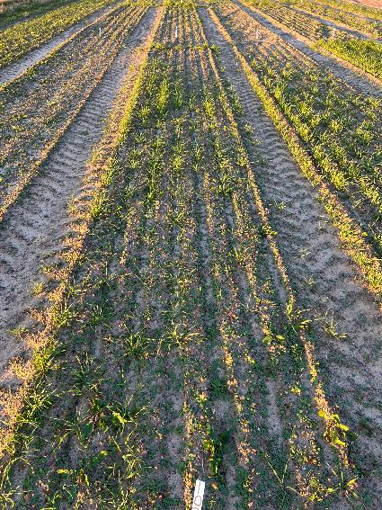
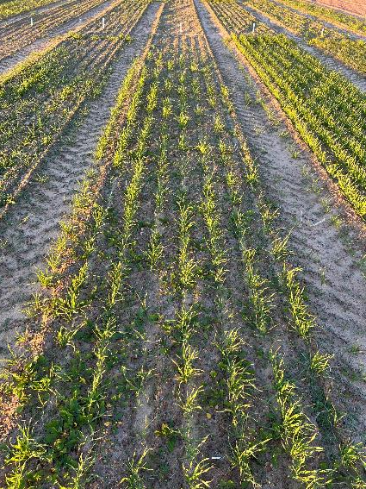
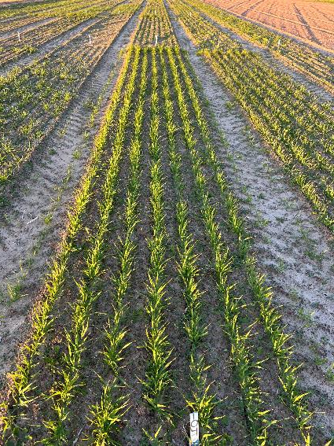
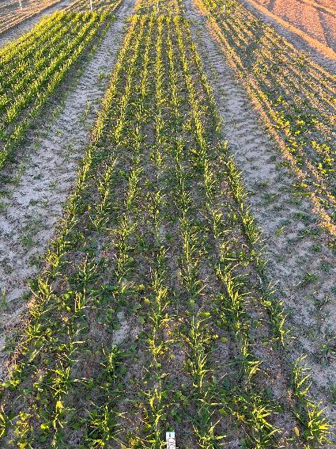
Small Grains
Rye – Wrens Abruzzi
75 lb/A
Rye – FL 401
75 lb/A
Oats – Horizon (FL) 720
75 lb/A
Oats – Coker 227
75 lb/A

Slide 25
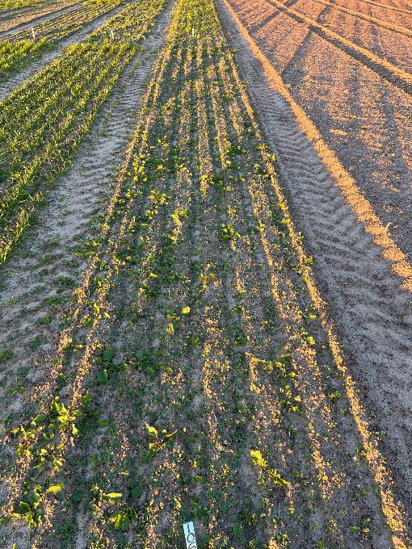
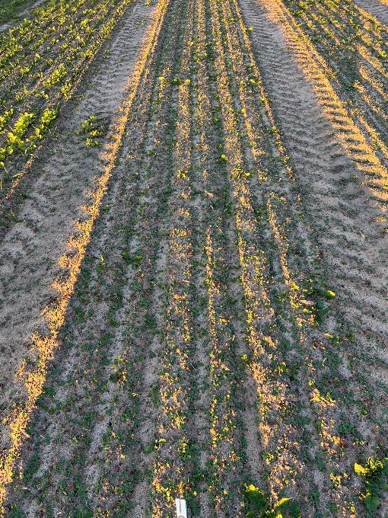
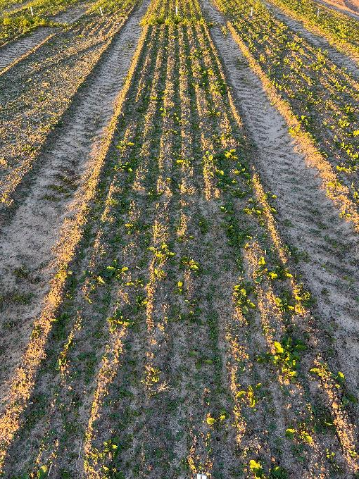
Clovers
Crimson Clover – AU Sunrise
12 lb/A
Crimson Clover – Dixie
12 lb/A
Balansa Clover – Fixation
12 lb/A

Slide 26
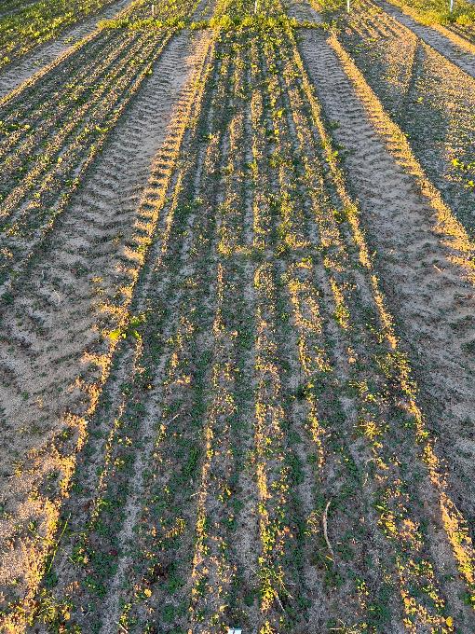
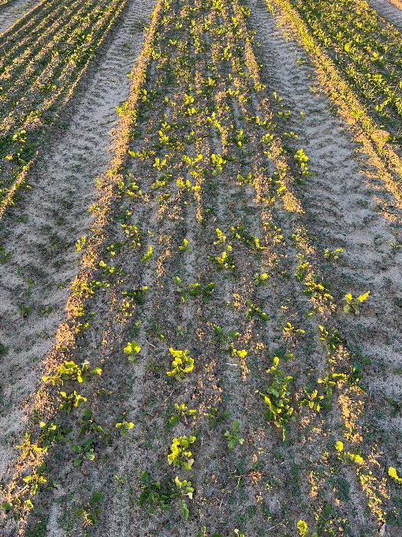
Vetch / Radish
Vetch – AU Merit
12 lb/A
Radish – Daikon Tillage
10 lb/A

Slide 27
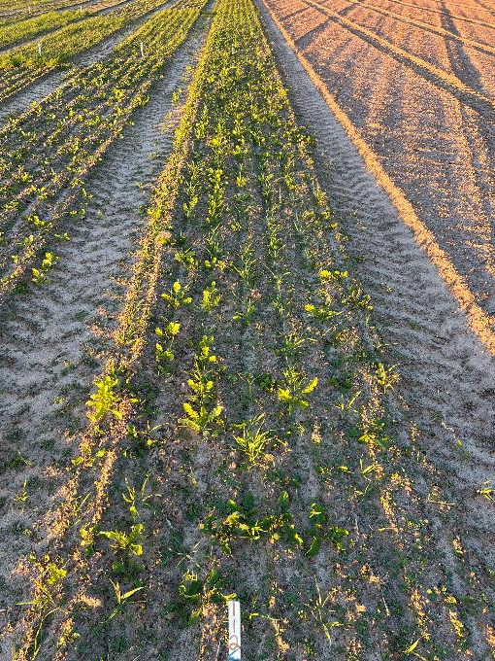
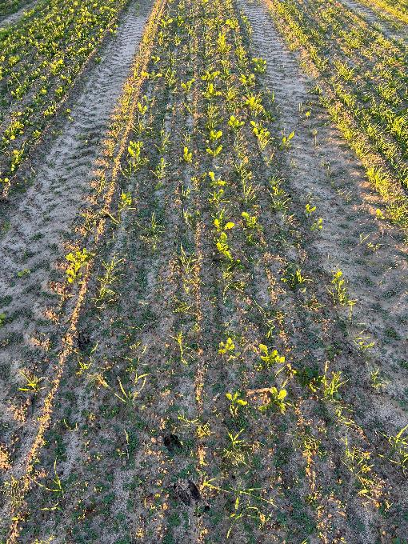
Commercial Pre-Mixes
Mixon Seed – ReVive Cotton
40 lb/A
Southeast Agriseeds – On Time Mix
40 lb/A

Slide 28
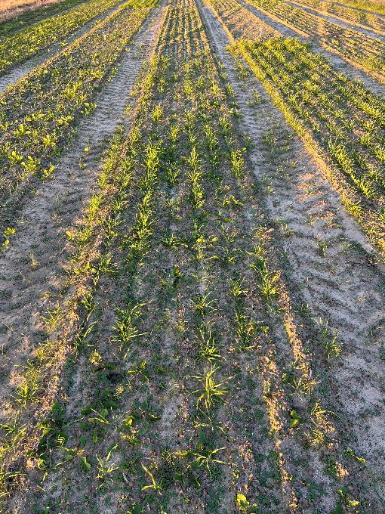
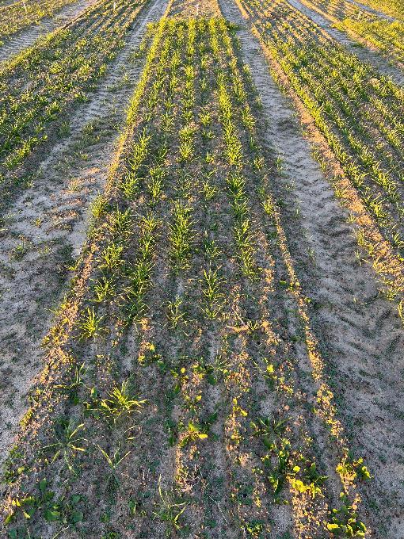
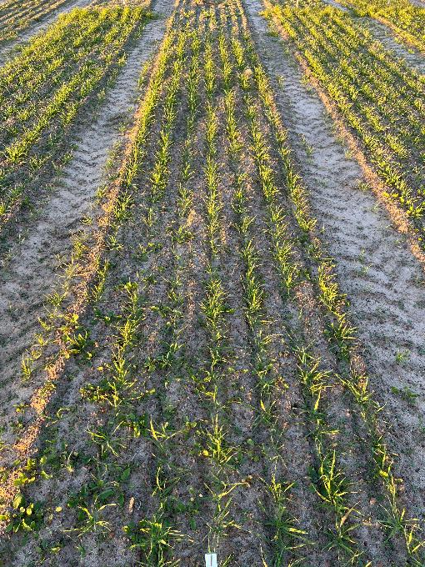
“Homemade” Mixes
Rye (Wrens Abruzzi) – 60 lb/A
Vetch (AU Merit) – 8 lb/A
Rye (Wrens Abruzzi) – 60 lb/A
Crimson clover (Dixie) – 8 lb/A
Rye (Wrens Abruzzi) – 30 lb/A
Oats (Horizon 720) – 30 lb/A
Crimson Clover (Dixie) – 5 lb/A

Slide 29
Small Grain Seeding Rates
Compare seeding rates by cultivar
  Cereal rye
    Wrens Abruzzi
    FL 401
  Oats
    Coker 227
    Horizon (FL) 720
Biomass accumulation, ground coverage, stand, ECONOMICS $$$
Broadcast Rate (lb/a)
100
75
50
40
30
20

Slide 30
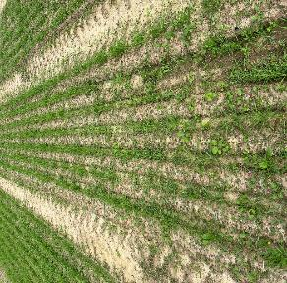
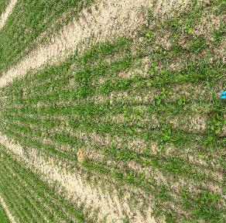










Small Grain Seeding Rates - Rye
Wrens Abruzzi
100 lb/A
75 lb/A
50 lb/A
40 lb/A
30 lb/A
20 lb/A
FL 401
100 lb/A
75 lb/A
50 lb/A
40 lb/A
30 lb/A
20 lb/A

Slide 31












Small Grain Seeding Rates - Oats
Coker 227
100 lb/A
75 lb/A
50 lb/A
40 lb/A
30 lb/A
20 lb/A
Horizon (FL) 720
100 lb/A
75 lb/A
50 lb/A
40 lb/A
30 lb/A
20 lb/A

Slide 32
Cover Crop Mixtures – NRCS Standards
Single Species | 2-way mix | 3-way mix | 4-way mix | 5-way mix
Rye | Rye + Clover | Rye + Clover + Vetch | Rye + Oats + Clover + Radish | Rye + Oats + Clover + Radish + Turnip
Clover | Rye + Vetch |  |  | Rye + Oats + Vetch + Clover + Radish
Following NRCS standards
  Rates, planting dates, mix composition
Biomass accumulation, ground coverage, stand, ECONOMICS $$$, cotton growth/yield

Slide 33


Cover Crops in Plasticulture

Slide 34


Money for Growers Floating Around
Climate-Smart Commodities Grant
  $3.1 billion for 141 project in US
  Cost-share, assistance, grants, etc.
  Projects 1-5 yrs
NRCS funding
  Oversubscribed
  IRA (’23-’27) will add additional $19.5 billion
  EQUIP, CSP, Ag Conservation easement, etc.

Slide 35
Cost-Share/Incentive Programs – Cover Crops
Climate-Smart Commodities Grant – cover crop specific
  5 different programs available in GA

Slide 36

US Cotton Trust Protocol / Climate Smart Cotton
*Part of USDA Climate Smart Commodities grant
Enrollment
Jan-April 2025
Can enroll self
Enroll @ gin
Contact Maryn
Contact
Maryn Findley
352-805-3907
mfindley@cotton.org
www.trustUScotton.org

Slide 37

Sustainable U.S. Peanuts Initiative
*NOT Part of USDA Climate Smart Commodities grant
Enrollment
July 2024-April 2025
Self enrollment
Enrollment day @ buying point?
Contact
Allie Randell
386-209-2951
arandell@peanutusa.com
www.sustainableUSpeanuts.org

Slide 38


Thank you!

